Slide 1
COMP2106 – Advanced Server Side Scripting
Lesson 6 – Intro to MongoDB and Mongoose

Slide 2
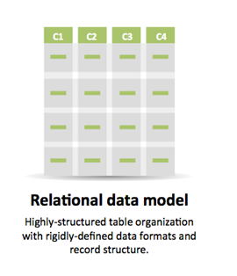
The Origins of NoSQL
The NoSQL concept evolved as a response to the scaling problems encountered by web applications with relational databases
In relational databases, data is stored throughout the database and reconstructed in the application logic through the creation of objects. This “Object-Relational Mapping” (ORM) requires significant design and coding work.
The relational model is extremely inflexible…what happens when a new field needs to be added or the data rules change? What would an example be?

Slide 3
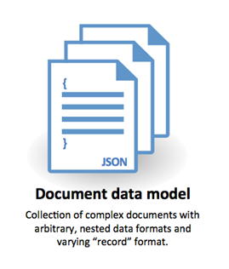
The NoSQL Alternative
NoSQL databases offered developers another data storage mechanism: “documents” which usually store data in key-value pairs
NoSQL documents are designed for high performance and scalability as they are schema-less: each “record” in the same document can actually have a different format and the format simply evolves over time without the requirement to modify the document structure first
Documents can be nested inside other documents eliminating the need to create table relationships, foreign keys, and joins
NoSQL’s horizontal scaling makes it perfectly suited to cloud hosting solutions, which can automatically scaled based on user demand

Slide 4
A Sample MongoDB Document
{ "_id" : ObjectId("54c955492b7c8eb21818bd09"), "address" : { "street" : "2 Avenue", "zipcode" : "10075", "building" : "1480", "coord" : [ -73.9557413, 40.7720266 ], }, "borough" : "Manhattan", "cuisine" : "Italian", "grades" : [ { "date" : ISODate("2014-10-01T00:00:00Z"), "grade" : "A", "score" : 11 }, { "date" : ISODate("2014-01-16T00:00:00Z"), "grade" : "B", "score" : 17 } ], "name" : "Vella", "restaurant_id" : "41704620“ }
Each document represents a “record”
Documents are stored in “collections”
Different documents in the same collection can have different schemas (unlike records in a relational database table
Documents are structured with key / value pairs
A document field can contain another document, an array, or an array of other documents
All documents must have a unique _id field as primary key. MongoDB automatically adds this field to every collection
Further reading: https://docs.mongodb.org/getting-started/node/

Slide 5

Why MongoDB?
Created in 2007 and coming from the word “humongous”, MongoDB is the world’s most popular NoSQL database
Data storage in the form of BSON – Binary JSON. These key/value pairs are extremely fast and play well with Node and Express as both our application code and the data itself are in JavaScript format.
Supported by most cloud hosting platforms
Includes automatic unique ObjectID
Supports adhoc queries with a very lightweight syntax:
db.posts.find({ title:/mongo/ });

Slide 6

How do I get MongoDB?
Download and install from www.mongodb.com
Run in the cloud for free at www.mongolab.com
Enable as an Azure add-on

Slide 7

Configuring MongoDB
MongoDB is self-contained and does not have any other system dependencies. You can run MongoDB from any folder.
For simplicity, copy all files from the extracted mongo bin folder (in c:\program files\mongodb\server\3.0\bin) to a new users\node\mongodb directory (e.g. c:\users\username\node\mongodb)
MongoDB requires a data directory to store all data. The default data directory path is \data\db. Create c:\users\username\node\data\db
You can also run MongoDB as a Windows Service

Slide 8

Command Line Mongo
Open a command prompt and browse to your node/mongodb folder
First we need to start the server:
mongod --dbpath c:\users\username\node\data
Notice the default port: 27017
Open another command prompt and again browse to the node/mongodb directory
Start a mongo command session:
mongo

Slide 9
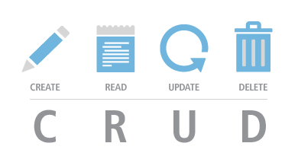
CRUD Operations with MongoDB
First we need to connect to a database (or create a new one)
Mongo comes with a “test” database pre-installed, so let’s use it:
use test;
To create documents:
db.beers.insert( { name: “Steamwhistle”, type: “Pilsner”} ); db.beers.insert( { name: “Sleeman Cream Ale”, type: “Ale”, onSale: true } );
Notice we neither had to create the beers collection first, nor define any schema for it. In fact, our 2 documents have slightly different schemas

Slide 10
CRUD Operations with MongoDB
Query the data:
db.beers.find().pretty();
Notice the unique _id field of type ObjectId that Mongo auto-generates
Update a document
By default Update modifies a single document, though there is a multi option: db.beers.update( {name: “Sleeman Cream Ale”, $set: { onSale: false } } );
Adding multi: true to the above would update multiple records

Slide 11
CRUD Operations with MongoDB
To delete documents:
db.beers.remove( { name: “Steamwhistle” } );
The remove() function takes an optional parameter which specifies how many documents should be deleted

Slide 12
Introducing Mongoose
How does Node talk to MongoDB? The most common way is via the Mongoose npm package
Find out more at http://www.mongoosejs.com
(Click the arrow when in Slide Show mode)
Notes:
In Slide Show mode, click the arrow to enter the PowerPoint Getting Started Center.

Slide 13

Mongoose
Mongoose is an Object – Document Mapper (ODM)
In the words of the Mongoose team:
“Mongoose provides a straight-forward, schema-based solution to model your application data. It includes built-in type casting, validation, query building, business logic hooks and more, out of the box.”
Mongoose helps our Node apps enable MVC patterning
var mongoose = require('mongoose'); mongoose.connect('mongodb://localhost/test');
var Cat = mongoose.model('Cat', { name: String }); var kitty = new Cat({ name: 'Zildjian' }); kitty.save(function (err) { if (err) // ... console.log('meow'); });

Slide 14

Step 1: Add some test data
To add article documents:
db.articles.insert( { created: “10/1/2015”, title: “Our First Article”, content: “This will be really interesting some day.” } );
db.articles.insert( { created: “10/2/2015”, title: “Here is number two!”, content: “This is even more fascinating.” } );
db.articles.insert( { created: “10/3/2015”, title: “Day 3: Article 3”, content: “OK, this one is rather boring.” } );

Slide 15
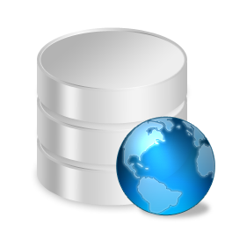
Step 2: Connect in app.js (for now)
In app.js, we need to link to the mongoose package, then try connecting:
var mongoose = require(“mongoose”); mongoose.connect(“mongodb://localdb/test”); var db = mongoose.connection; db.on(‘error’, console.error.bind(console, ‘Connection Error’); db.once(‘open’, function(callback) { console.log(‘Connected to mongodb’); });
Let nodemon restart your app then check the console for a message

Slide 16

Step 3: Build a mongoose schema
We need to build a schema or model to represent the articles collection within our Node application – models/article.js (notice the name is singular by convention)
Our model needs to require mongoose
We instantiate a new schema
Then we define the schema in JSON format – what does a document in this collection look like?
Make the model visible to other parts of the application

Slide 17
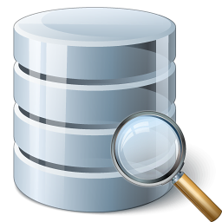
Step 4: Write the Read method in the Route
Mongoose models have built-in CRUD methods we can leverage rather than writing our own
Let’s build an articles page that uses the schema defined in models/article.js to retrieve and display a list of articles
Add a link to the header.ejs view, now prefixed with ../ as we are inside a sub-folder
Create routes/articles.js and add a GET handler for the path /articles
Link to this new route in app.js
Create views/articles/index.ejs to display the data.

Slide 18
Step 5: Adding new data
Let’s build an input form at views/articles/add.ejs
Then we need a GET handler inside routes/articles.js to load the form. Let’s also add a link to this page at the top of our views/articles/index.ejs
Now we need a POST handler in routes.articles.js to save the new record and redirect back to the main articles page

